Slide 1

NeuroDOT
Tutorial:
Data Organization

Slide 2
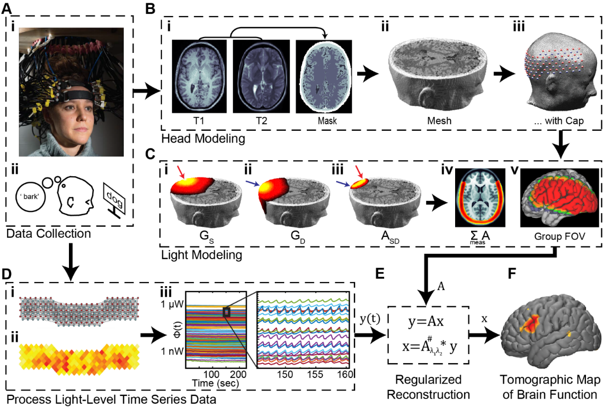
Motivation
NeuroDOT is a self-contained toolbox and aims to facilitate community adoption of standardized and flexible fNIRS and DOT techniques for data processing and analysis.
NeuroDOT provides a framework for processing, modeling, analyses, and visualization of fNIRS and DOT optical functional neuroimaging data.
This tutorial will inform you of the many types of data NeuroDOT interacts with and unpacks the information used in different stages of processing and analyses.
Wheelock MD, Culver JP, Eggebrecht AT. High-density diffuse optical tomography for imaging human brain function. Rev Sci Instrum. 2019

Slide 3
Table of Contents
Title
Motivation
Table of Contents
Data Types Flow Chart
What is data?
Neuroimaging Data Types
Intro to Optical Imaging Data
Intro to Volumetric Data
Raw Data – Data
Raw Data – Metadata – info.optodes
Raw Data – Metadata – info.pairs
Raw Data – Metadata – info.paradigm
Raw Data – Metadata – info.system, info.misc
Volumetric Data - Overview
Volumetric Data – NeuroDOT Metadata Structure
Volumetric Data – Number of Voxels
Volumetric Data – Voxel Size
Volumetric Data – Orientation
Volumetric Data – Loading and Saving in NeuroDOT
Volumetric Data – History
Volumetric Data – Transforms
Volumetric Data – Transforms - Interpolation Type
Mesh Data – Overview
Mesh Data – Light Modeling
Mesh Data – Types of Meshes
Pad and A – Overview
Pad File – Overview
Pad File – info.tissue
Pad File – info.tissue visualized
Pad File – Loading and Saving
A Matrix – Dimensions and Measurements
A Matrix – Matching to Data
A Matrix – Saving and Loading
Reconstructed Data – Overview
Reconstructed Data – Data Objects
Reconstructed Data – Metadata Objects
Reconstructed Data – Visualization
Contact the NeuroDOT Team

Slide 4
Data Types Flow Chart
data
Raw Measurement Data
Legend
Data Type
Data Format
Data Variable
Metadata Variable
info
.mat
.nirs
.snirf
Volumetric Data
volume
infoT1
dim
Nifti (.nii)
4dfp (.4dfp)
NeuroDOT conventions in MATLAB
Neuroimaging Data on Drive
Surface/Mesh Data
Anat
mesh
Pad and A
A
info
Data contains values
Metadata contains information about the data, e.g.
The space data is in
How the data was acquired
Other attributes of the data
muA
Hb
Reconstructed Data
info

Slide 5
What is Data? What do we know about it?
Before we go in depth into the conventions that NeuroDOT uses for handling data, we first need to talk about what data is, and what it means. To do that, we’ll answer the following 2 questions
What is the thing we’re looking at?
What do we know about the thing?
Data is the thing. It’s a variable comprised of values corresponding to some phenomenon in some space. For example:
Light intensity values or Hemoglobin concentrations.
Anatomical structures.
Correlation coefficients.
Metadata is what we know about the thing. It is also a variable, and it contains information that is crucial for interpreting the data.
The space that the data is in (e.g., size, shape, resolution).
Where the data comes from (e.g., imaging type/system, acquisition process).
What was happening when the data was collected (e.g., Experimental design information).

Slide 6

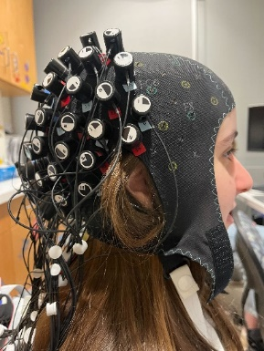
Neuroimaging Data Types
Optical imaging system data
Data from the imaging system: Light intensity, absorption, scattering, etc.
Examples of imaging systems: WashU custom built, LUMO by Gowerlabs, NIRSport2 by NIRx.
Types of file formats: .mat, .nirs, .snirf.
Volumetric data
Image data from MRI, CT, DOT, or other types. These may be participant specific or represent some common atlas object.
Types of file formats: .nii, .4dfp.
Mesh data
A set of vertices, edges, and faces that defines the shape of a polyhedral object in space.
Types of file formats: gifti, .mat, nirfaster style, .stl
WashU
LUMO
NIRx
NeuroDOT
NeuroDOT is system agnostic. NeuroDOT is equipped to handle all types of fNIRS data, regardless of what imaging system the data comes from.
Eggebrecht et al. Mapping distributed brain function and networks with diffuse optical tomography. Nature Photonics. 2014

Slide 7
Neuroimaging Data Types – Optical Imaging Data
There are two commonly used file formats for optical neuroimaging. Most commercial systems have options for saving data from the system in NIRS or SNIRF formats.
NIRS: https://github.com/BUNPC/Homer3/wiki/HOMER3-file-formats
SNIRF: https://github.com/fNIRS/snirf
NeuroDOT has conversion functions for both .nirs and .snirf file formats. These functions can be found in the Functions/File_IO subfolder.
NIRS: [data, info] = nirs2ndot(‘filename’, save_file, ‘output’);
SNIRF: [data, info] = snirf2ndot(‘filename’, save_file, ‘output’, ‘type’);
The input: save_file is an indicator that can be set to 1 or 0 depending on whether or not you’d like to save the variables to a .mat file.
1: saves a new .mat file containing data and info to the current folder.
0: suppresses saving a new .mat file with data and info.

Slide 8
Neuroimaging Data Types – Volumetric Data
4dfp and Nifti are two volumetric data types that NeuroDOT interacts with. Each data type has a different way of organizing its metadata.
But, have no fear! NeuroDOT unpacks all the metadata and organizes it in NeuroDOT format for easy interpretation.
4dfp: 4-dimensional floating point.
Created by Dr. Avi Snyder, based out of Washington University in St. Louis.
https://4dfp.readthedocs.io/en/latest/
Nifti: Neuroimaging Informatics Technology Initiative.
Created to introduce a standardized and informative file format for neuroimaging data back in 2003.
https://brainder.org/2012/09/23/the-nifti-file-format/
For more information on how to load and save volumetric data with NeuroDOT, see slide 19.
Notes:
Not going to go into the ANALYZE 7.5 file format that 4dfp uses and that Nifti was created to replace

Slide 9
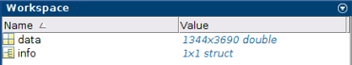
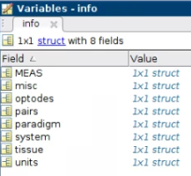
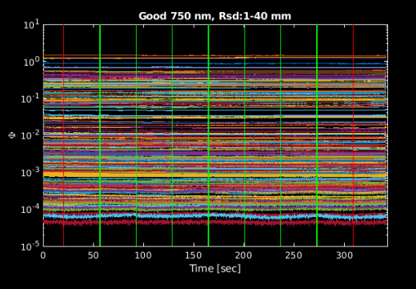
Data – Dimensions & Data Samples
NeuroDOT CCW2 Example Raw Data
Variables, info structure,
and raw data time traces
Once a file that contains optical imaging data is loaded into Matlab, there will be two variables in the workspace, data and info.
data: raw optical neuroimaging data.
Size: Number of Measurements x Number of Samples.
info: metadata structure containing the following fields.
Optodes: locations of sources and detectors in 3D and 2D.
Pairs: measurement list.
Paradigm: stimulus timing information.
System: framerate of imaging system.
Misc: extra data that doesn’t fit into the other fields.
MEAS: structure containing multiple measurement-level data quality assessments generated during processing.
Other fields may be present in the info structure, most of these will be discussed on later slides.
NeuroDOT has several data samples available in the \Data\ subfolder.

Slide 10
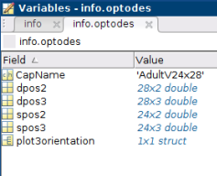
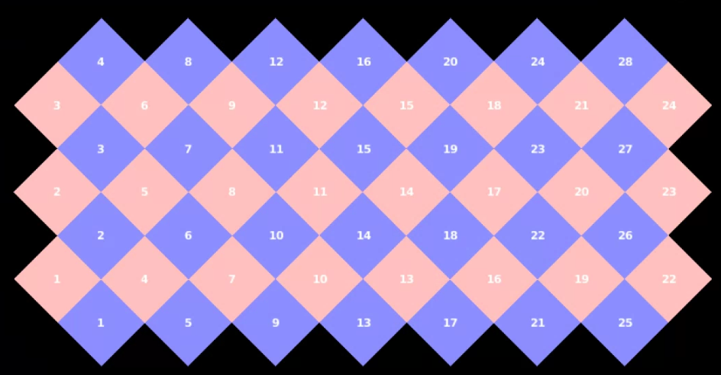
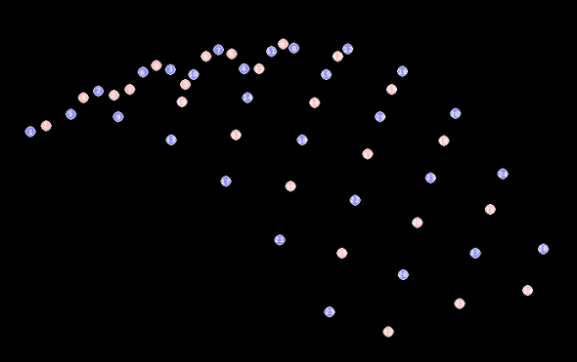
Info Structure – Optodes
Optodes Substructure
info.optodes contains the 2D and 3D xyz coordinates of optodes for the imaging system along with the name of the imaging cap.
Fields:
spos2: 2D source coordinates.
dpos2: 2D detector coordinates.
spos3: 3D source coordinates.
dpos3: 3D detector coordinates.
You can visualize the layout of the cap using the following NeuroDOT function: PlotCap.
PlotCap(info);
2D
3D
Notes:
Should build in functionality that automatically turns off axes and sets bg to black when 3D parameter used for PlotCap

Slide 11
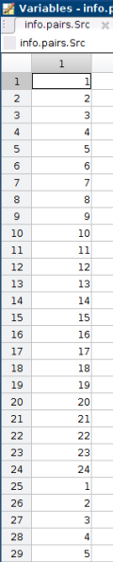
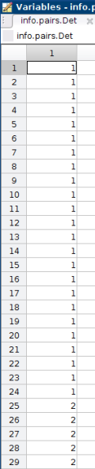
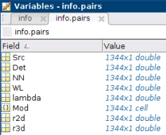
Info Structure – Pairs
Source and Detector lists
info.pairs contains key information about all measurements in the same order as they are represented in the data. Fields include:
Src: source list.
Det: detector list.
NN: Nearest neighbor classification.
WL: Wavelength index.
Lambda: Wavelength value (in nm).
Mod: ‘CW’ for continuous wave systems.
Or modulation frequency for frequency domain systems.
r2d: 2D source-detector separation distances (in mm).
r3d: 3D source-detector separation distances (in mm).
Organization: monotonically increasing sources within monotonically increasing detectors within wavelengths.
S1 → Sn for D1, D2, …, Dn for WL1 → WLn.
This organization is the way WashU orders our data.
Data for commercial systems may be ordered differently.
NeuroDOT supports any ordering style. The most important thing is that the order seen in the info.pairs fields matches the order in the data.
Pairs Substructure

Slide 12
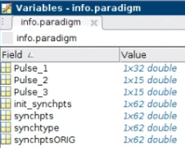
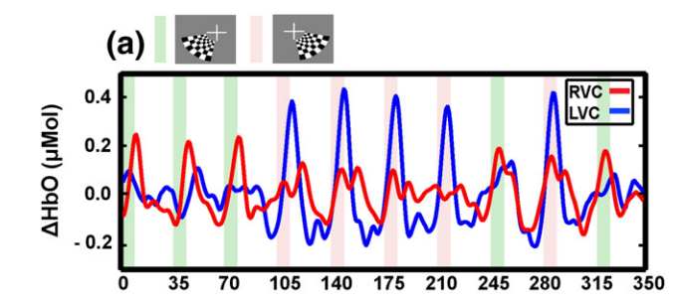
Info Structure – Paradigm
Example Paradigm Structure
info.paradigm contains event information for the stimulus paradigm used during an imaging session.
Fields
synchpts: indices (in samples) where an event happens.
This field gets changed whenever the data is re-sampled. Synchpoints are re-sampled to match the data.
init_synchpts: the original synchpts field before any processing occurs.
synchtype: numerical value indicating what kind of event occurred.
Numerical value is arbitrary, though don’t choose the same value for different events.
Eg: 0 = rest, 1 = checkerboard flashing.
Pulse: indices relative to info.paradigm.synchpts for each individual type of event.
Pulse_1 is generally for the beginning of a rest epoch.
Pulse_2 through N+1 (for N events) are associated with tasks.
synchtimes: times (in seconds) where events happens.
Paradigm information aligned with data traces. (Hassanpour et al. 2014)
Orange lines at the end of each green/pink bar are rest synchpoints. These would be classified as Pulse_1.
Green bars are events where the checkerboard is flashing on the left side of the screen. The start of these bars would be synchpoints classified as Pulse_2.
Pink bars are when the checkerboard flashes on the right side of the screen. The beginning of these bars are Pulse_3 synchpoints.
Note: the info.paradigm structure shown above is for an elongated version of the task shown in the Hassanpour figure.

Slide 13
Info Structure – System and Misc
info.system houses information about the imaging system used, and typically contains two fields.
framerate: framerate that corresponds to the data.
This field gets modified during processing when the data is resampled.
init_framerate: framerate of the imaging system.
This field never gets modified.
info.misc contains any extra information that might be useful, such as:
Number of sources, detectors, and wavelengths for the imaging system.
Pad file, optodes and pairs fields only.
Start and end times of the scan.
Other information about the data acquisition system.
Raw data from the stimulus audio or video.

Slide 14
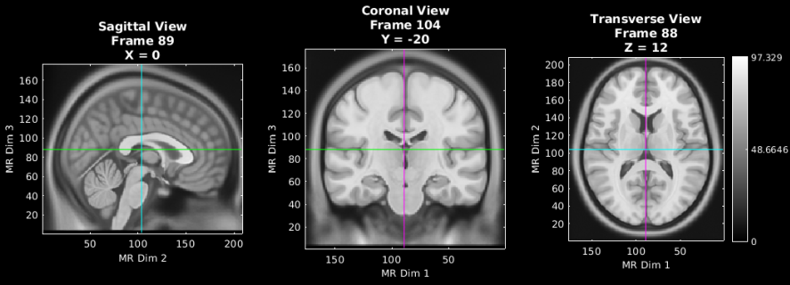
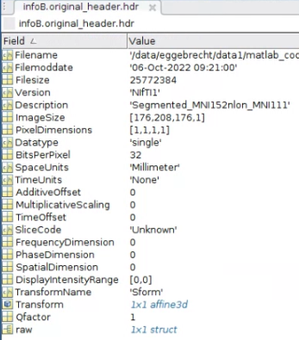
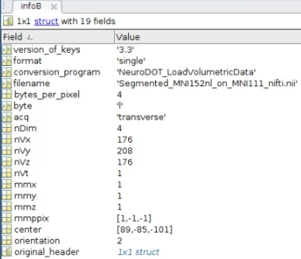
Volumetric Data – Overview
Volumetric Data
To talk about volumetric data, lets use a T1 MRI as an example.
Data: MRI image volume. A collection of numbers that make up an 3D image. In the figure on the right, these numbers are gray-scale values. Other volumetric data examples include:
Atlases and Participant MRIs, e.g. T1, T2.
CT data.
Functional data, e.g. fMRI, reconstructed fNIRS or DOT.
Metadata: Information describing how the data is organized and related to some conventional space. Metadata generally contains at least minimal information about how the data are arranged, such as:
Number of voxels in each dimension (X, Y, Z).
Size of each voxel.
Orientation of the image.
Common file types for volumetric data are Nifti and 4dfp.
Nifti: https://brainder.org/2012/09/23/the-nifti-file-format/
4dfp: https://4dfp.readthedocs.io/en/latest/
Volumetric Metadata
Nifti
NeuroDOT

Slide 15
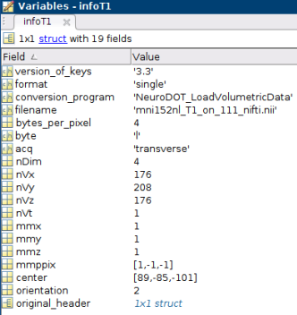
Volumetric Data – NeuroDOT Metadata Structure
Metadata Structure for MNI152 on 1mm voxellation
NeuroDOT’s metadata structure for volumetric data contains fields detailing information about the space the volume is in.
Filename: name of data file.
acq: orientation of the image.
Transverse, coronal, or sagittal.
nDim: number of dimensions, this will most often be 4.
nVx, nVy, nVz: number of voxels in each dimension (X,Y,Z).
nVt: number of values in the 4th dimension, typically time points.
mmx, mmy, mmz : voxel size in each dimension (X,Y,Z).
mmppix: vector that relates to how coordinate space changes in a given dimension, relative to changes in the indices of the data in that dimension.
center: Vector that points from voxel at index [0,0,0] to the center of the volume.
-1,-1,-1 in languages with 0 indexing.
orientation: orientation of how the image is stored in the volume (numerical representation).
Transverse = 2, coronal = 3, sagittal = 4.
original_header: metadata from the original file type, for nifti only.

Slide 16
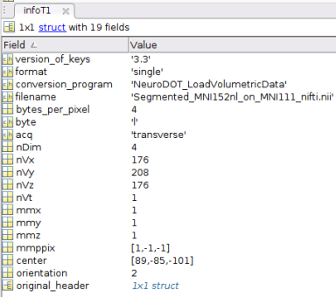
Volumetric Data – Number of Voxels
NeuroDOT uses the following naming conventions for number of voxels.
X dimension: nVx
Y dimension: nVy
Z dimension: nVz

Slide 17
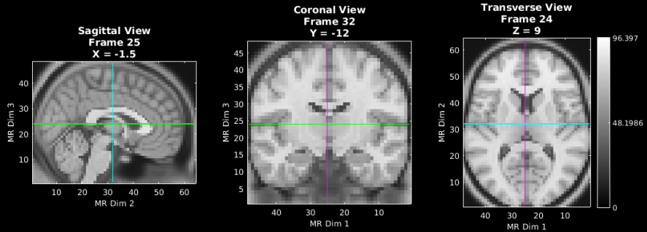
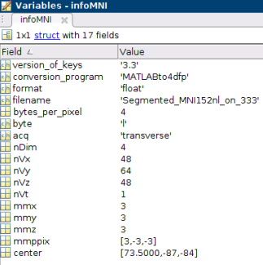
Volumetric Data – Voxel Size
MNI152 atlas with 1mm voxels
In NeuroDOT’s volumetric metadata structure, there are several fields that can tell you this information. We denote size in millimeters, always.
Fields denoting voxel size are in red boxes.
Here we show the same atlas with two different voxel sizes, 1mm and 3mm.
MNI152 atlas with 3mm voxels
Notes:
Discuss resolution vs voxel size with Adam

Slide 18
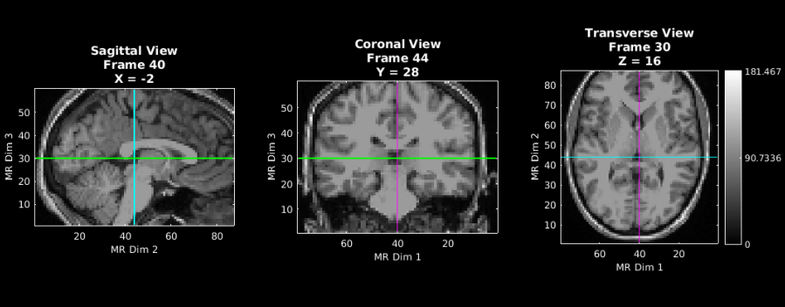
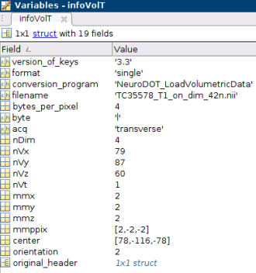
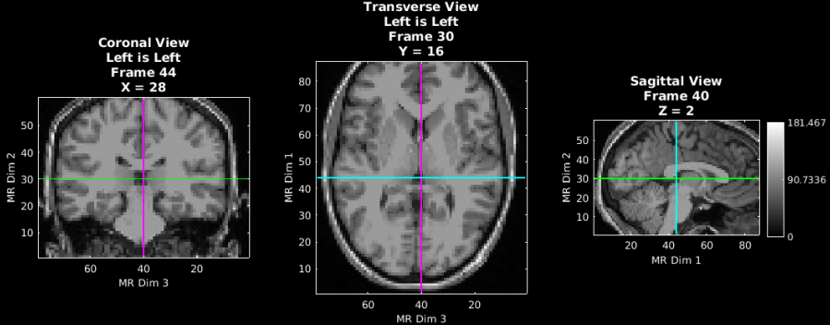
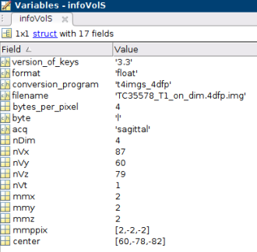
Volumetric Data - Orientation
Volume in Transverse orientation
Volumes can be organized in different orientations.
Names for orientation are given by the axis of the third dimension.
NeuroDOT uses the field “acq” to denote orientation.
The view that corresponds to the orientation, will be shown on the rightmost axes.
nVx always corresponds to the number of voxels in dim1, nVy for dim2, and nVz for dim3.
The three views are always “looking down” the axes.
Left: looking down dim1.
Middle: looking down dim2.
Right: looking down dim3.
Volume in Sagittal orientation
Notes:
Talk about this slide with Adam to disambiguate orientation vs acquisition

Slide 19
Volumetric Data – Loading and Saving with NeuroDOT
NeuroDOT has two functions for loading and saving volumetric data. Both functions are located in NeuroDOT/Functions/File_IO.
LoadVolumetricData.
SaveVolumetricData.
These functions can also be used in tandem to convert volumetric data from the 4dfp format to Nifti format or vice versa.
Simply load a volume that’s in one format and then save it as the other format.
Code
[data, metadata] = LoadVolumetricData(‘filename’, ‘path to file’, ‘file type’);
SaveVolumetricData(data, metadata, ‘filename’, ‘path to save folder’, ‘file type to save as’);
Notes:
Update this slide when the subject specific tutorial is released

Slide 20
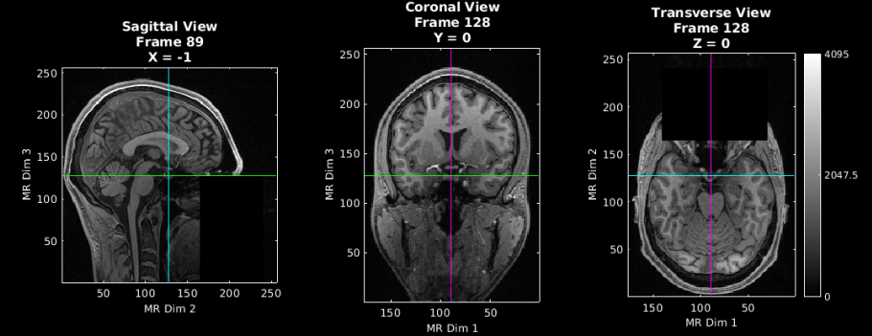
Volumetric Data – Where Does it Come From?
An atlas is particularly useful for group-wise analyses, serving as a common space to register data from participants to.
References for two adult and one pediatric atlases commonly used in neuroimaging:
Talairach: https://en.wikipedia.org/wiki/Talairach_coordinates
MNI: https://www.mcgill.ca/bic/software/tools-data-analysis/anatomical-mri/atlases/icbm152-non-linear-2009
M-CRIB neonatal atlas: https://osf.io/4vthr/
Participant specific anatomy via an MRI or CT or other modality may have the anatomy in a non-standard location and orientation within the volumetric field of view.
Atlas
Participant

Slide 21
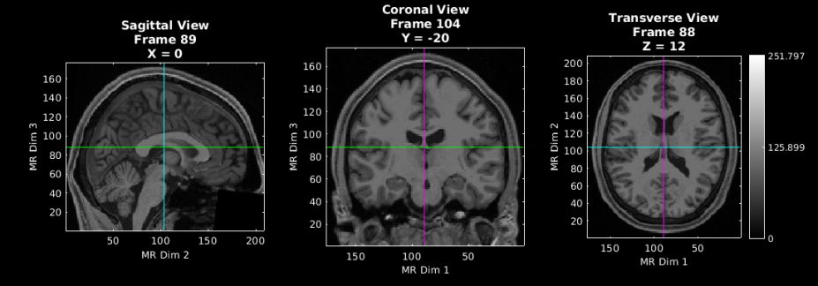
Volumetric Data – Transforms
Atlas
To transform a participant’s volume to an atlas for group analyses, use the NeuroDOT function: affine3d_img.
Vol_tform: volume transformed to atlas space.
Vol: original participant volume (MRI).
infoVol: metadata structure for participant volume.
infoAtlas: metadata structure for atlas volume.
Affine_matrix: matrix that provides the information to transform one volume to another space.
Info the affine matrix may contain translation, scaling, rotation, skewing.
Is always a 4x4 matrix when transforming a 3D object.
Defaults to an identity matrix.
Linear: interpolation method.
Defaults to linear, which is the method used for data.
‘nearest’ is the interpolation method used for masks, more on this on the next slide.
[vol_on_atlas] = affine3d_img(vol, infoVol, infoAtlas, affine_matrix, ‘linear’);
Participant
Participant Transformed to Atlas

Slide 22
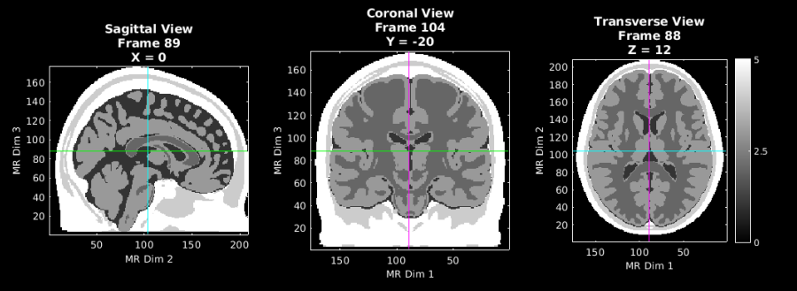
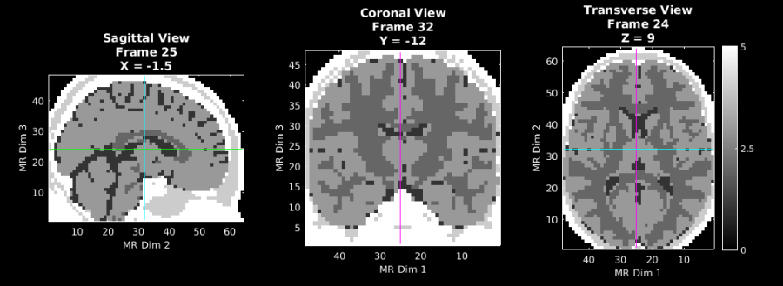
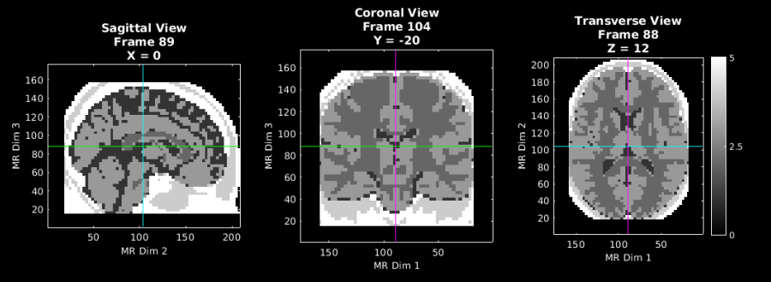
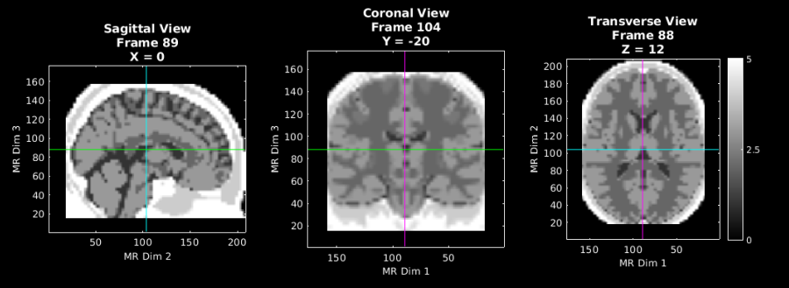
Volumetric Data – Transforms: Interpolation Type
1mm
3mm
Two commonly used interpolation types, each has a different use case.
Nearest Neighbor interpolation is used for masks, and it preserves the data in each voxel during the transform.
The values in a mask are typically integers corresponding to some label, such as anatomy.
When transforming a mask, we want the labels to stay the same value.
When this method is used on data, the data can become pixelated.
Linear interpolation is used for data and allows for a smoother transformed image.
Better for data than masks.
Nearest
Linear

Slide 23
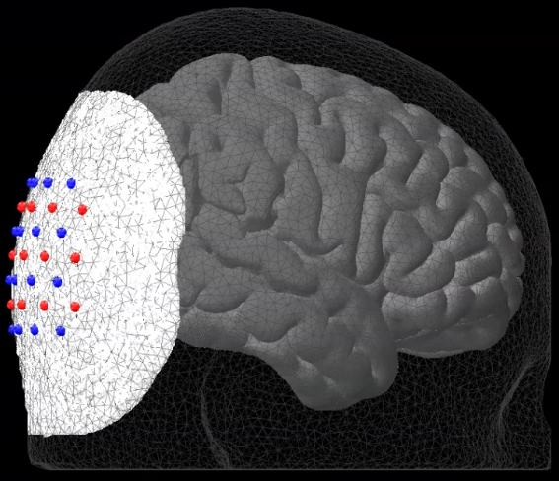
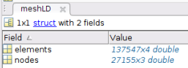
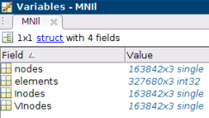
Mesh Data – Overview
Meshes are used in a variety of processing stages in NeuroDOT, such as:
Array placement in head modeling pipelines.
Calculating the sensitivity of an array in light modeling pipelines.
Visualizations in processing pipelines.
Meshes are defined as a set of points that are connected by a 2D or 3D topology of elements.
Points can be called nodes or vertices.
2D uses a triangular topology, where 3D can use tetrahedral or cuboid topology.
Mesh data in NeuroDOT uses a 3D tetrahedral topology and are comprised of Nodes and Elements.
nodes: the interconnected points.
3D XYZ coordinates.
These are connected together to form elements.
Sometimes called vertices in other toolboxes.
elements: the tetrahedra that the mesh is comprised of.
Sometimes called faces or tetrahedra in other toolboxes.
Example Mesh Structures
Head
Brain

Slide 24
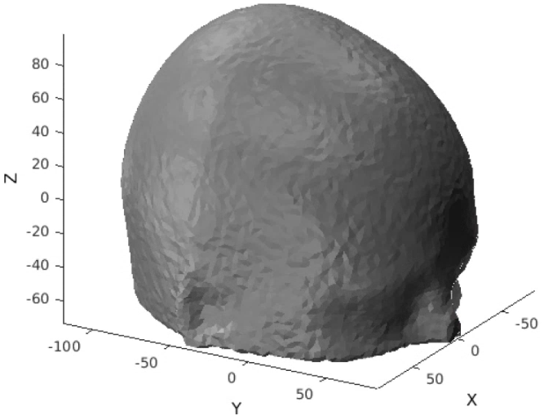
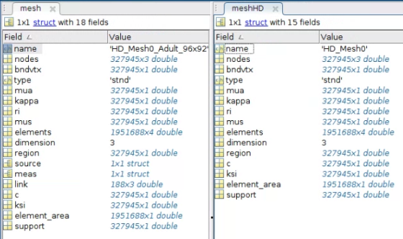
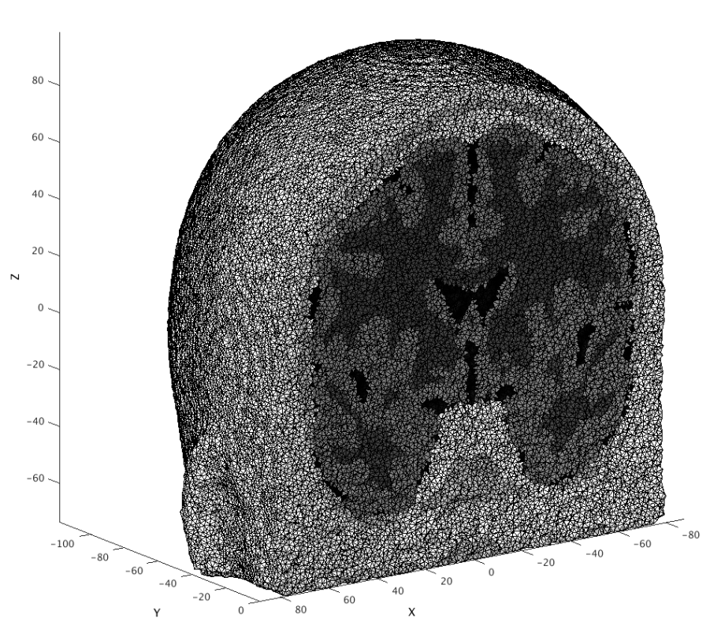
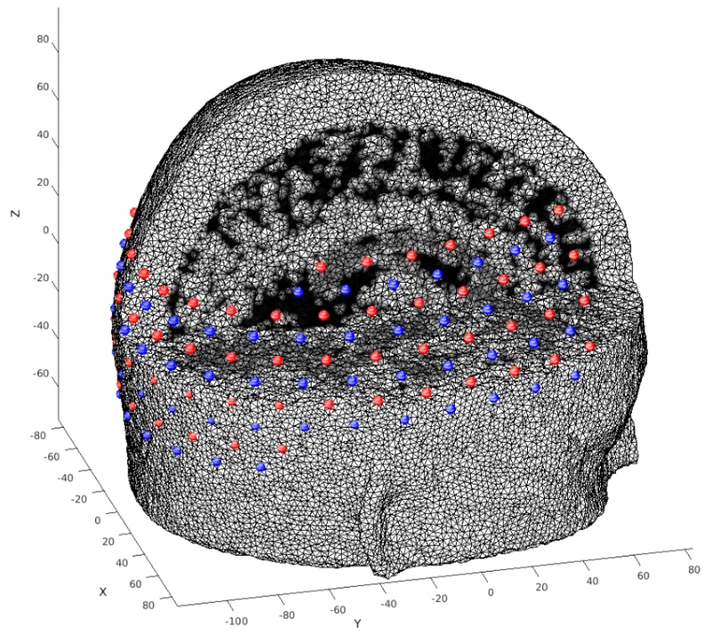
Mesh Data – Meshes in Light Modeling
Low Density
There are 3 meshes used in NeuroDOT’s light modeling pipelines.
Low Density
Simple mesh, only nodes and elements.
High Density
Contains the following anatomical info:
bndvtx: Boundary vertices.
mua: Absorption coefficients.
kappa: Photon diffusion coefficient.
mus: Scattering coefficients.
region: Anatomical labels for brain regions.
c: Speed of light in the tissue.
ksi: Boundary coefficient.
Prepared
Same nodes, elements, and anatomical info as HD mesh.
Optode locations and information.
source: XYZ optode locations, organized with sources first then detectors.
meas: field used by NIRFASTer.
link: field used by NIRFASTer.
High Density
Prepared

Slide 25
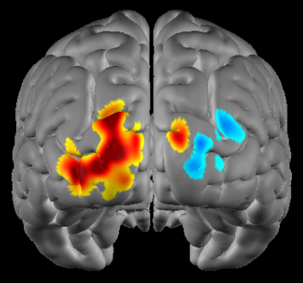
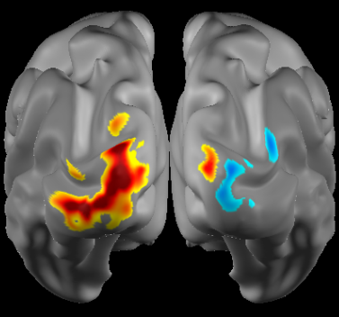
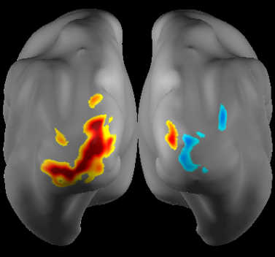
Mesh Data – Types of Meshes
Head Meshes
There are several types of meshes that are typically used in NeuroDOT pipelines. These can be broken down into two main categories: head and brain.
Head meshes.
2 main types: low and high density.
HD meshes are used for:
Precision in array placement.
Accurate modeling of light transport through the volume using NIRFASTer or Monte Carlo Simulation.
Check out the Generating a Light Model tutorial for more information and detailed instructions on how to make a head mesh.
Cortical meshes.
Can be visualized with different inflations.
Check out the Subject Specific Head Modeling tutorial to learn how to create a brain mesh.
Low Density
High Density
Cortical Meshes
Standard
Inflated
Very Inflated

Slide 26
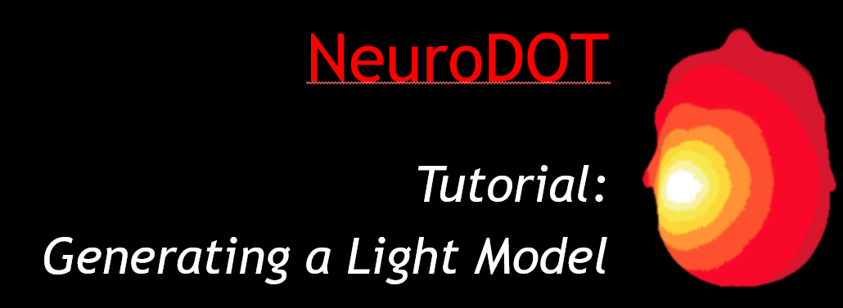
Pad and A – Overview
In NeuroDOT, the Pad File and A matrix generation process is where everything we’ve gone over so far comes together. This process is known as “Generating a Light Model.”
The model is based off volumetric data and once generated, allows for the reconstruction of raw fNIRS data into images projected onto the surface of the brain.
A Matrix: model of how light propagates through a head containing tissues with given optical properties.
Name in code: A.
Size: Number of Measurements x Number of Voxels in the underlying volume.
Pad File: metadata structure containing all information.
Name in code: info.
Fields: optodes, pairs, tissue.
info.Tissue: volumetric metadata structure.
Check out our other tutorials for detailed instructions on how to make a light model

Slide 27
Pad File – Overview
The pad file is NeuroDOT’s representation of the imaging array.
It is a metadata structure called info, identical to the metadata structure associated with raw data (slides X-Z).
A Pad file contains the following fields which are made and used in the head and light modeling pipelines.
info.optodes: Optode locations in 3D and 2D.
Also in raw data info structure.
info.pairs: Measurement list.
Also in raw data info structure.
info.tissue: Volumetric information about the head model
New for pad file.
Pad file on Mesh
Optodes from the pad files optodes field visualized on a head mesh. Sources are in red and detectors are in blue.

Slide 28
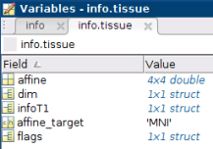
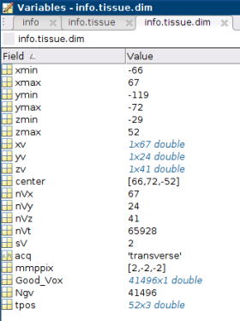
Pad File – info.tissue
Pad files are used to generate a light model known as the A matrix. At the end of the A Matrix generation process, volumetric information pertaining to the underlying anatomy, and the space that the A Matrix itself is in, are placed within the info.tissue metadata structure.
Fields
dim: Volumetric metadata corresponding to the space the A Matrix is in.
infoT1: Volumetric metadata structure corresponding to the space of the volumetric data used to generate the A Matrix.
affine: Affine matrix to transform data to some shared space for group analyses.
Also contained in info.tissue.flags.t4.
affine_target: String denoting the target space that the data will be transformed to using the affine matrix in info.tissue.affine.
flags: List of parameters used in the A matrix generation process.

Slide 29
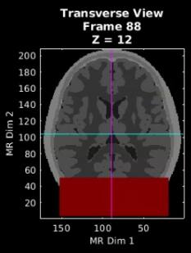
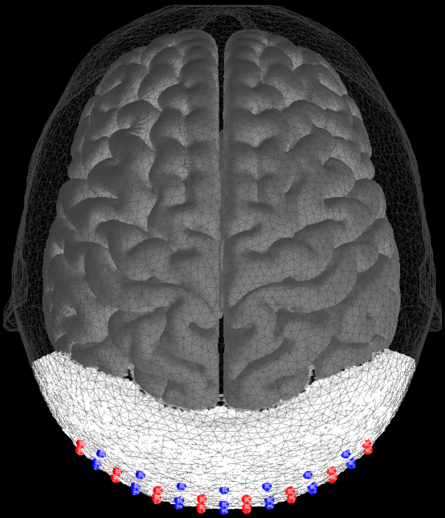
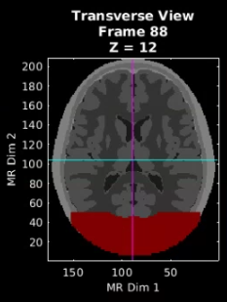
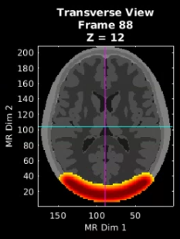
Pad File – info.tissue visualized
1.
Let’s visualize some the relationships of fields in info.tissue on top of a T1 using info.tissue.dim, dim.Good_Vox, and the data contained within Good_Vox.
Volume that is the size and position of info.tissue.dim.
Volume corresponding to info.tissue.dim.Good_Vox.
Info.tissue.Good_Vox lists the indices of info.tissue.dim that contain the calculated sensitivity for a given system. These voxels are where all of the data lives after reconstruction occurs.
Flat Field Reconstruction of the A Matrix’s sensitivity profile. This is essentially a field of view of the imaging array.
This is the type of data that lives within info.tissue.dim.Good_Vox.
2.
3.
Low density mesh (transparent) with brain mesh (grey), high density mesh (white), and optode array.

Slide 30
Pad File – Loading & Saving
Loading
Loading is simple, load the pad file like you would any other .mat file.
load([filename, '.mat'])
If the pad/info is packaged with another variable, such as the A matrix or a data file, and you want to load just the pad/info, specify that in the load function call.
load([filename, '.mat’], 'info’)
Saving
The pad file generation tutorial uses info.optodes.CapName to set the name of the file.
You can set the file name manually if you’d like.
save(['Pad_',info.optodes.CapName,'.mat'],'info’)
Pad files are always saved with their associated A Matrix at the end of the light model generation pipeline.

Slide 31
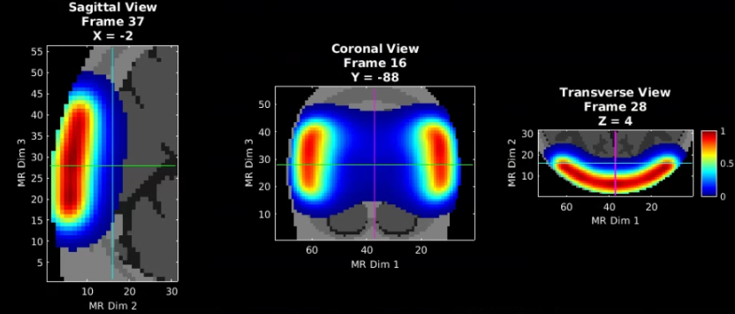
A Matrix - Dimensions & Measurements
An A Matrix, Light Model, or Jacobian, is a model of how light propagates through a head that is made up of some number of tissues with given optical properties.
In NeuroDOT, an A Matrix is always in the format of Number of Measurements x Number of Voxels, where:
Number of measurements is for all wavelengths used by the imaging system.
Nmeas is the same length as fields in info.pairs.
Number of voxels corresponds to the number of voxels in the underlying anatomy.
Nvox must be the same length as info.tissue.dim.Good_Vox.
Flat Field Reconstruction of A matrix visualized on underlying anatomy.

Slide 32
A Matrix – Matching to the Data
In NeuroDOT, the default method for A Matrix generation creates A with every possible measurement combination.
However, we have an option to create A with a pre-ordained subset of measurements.
Why?
Many commercial systems already have a set of measurements that the system is designed to use, and data from those systems is output only containing those measurements, not all possible measurements.
Including all possible measurements would increase noise in the data, as measurements with a large source-detector separation distance are quite noisy.
Options for A Matrix Generation in NeuroDOT
Generate A with all measurements, then crop to match the data after.
Generate A with a subset of all measurements that matches the data.
Check out one of our Generating a Light Model tutorials for specific examples on how to use the options above.

Slide 33
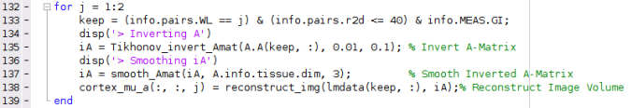
A Matrix – Saving and Loading
You should always save an A matrix using –v7.3 because A matrices are typically large files.
A is always saved with its info file. File sizes of the two A matrices included in the toolbox are below.
96 sources x 98 detectors: 2.2 GB.
24 sources x 28 detectors: 210 MB.
Code: save(['A_',flags.tag,'.mat'],'A','info','-v7.3’);
In NeuroDOT pipelines, the A matrix and its associated info file are loaded together as a structure with two subfields.
Subfields
A.A is the A matrix.
A.info is the info structure.
Code: A = load('filename');
This is done so the metadata structures from the A matrix and Data, which are both named info, can exist in the workspace at the same time.
In the above code snippet, info is associated with the data, A.info is associated with the A matrix.

Slide 34

Reconstructed Data - Overview
Using the A Matrix and the raw data, we can reconstruct images of what’s going on in the brain. This process is called Image Reconstruction.
For a hands on walk through of this process, check out the NeuroDOT Image Reconstruction tutorial.
Inputs
A Matrix and associated Info structure: A.A and A.info.
Preprocessed data and associated Info structure: lmdata and info.
Outputs
Absorption coefficients for near-infrared light in the brain: cortex_mu_a.
Hemoglobin concentrations in the brain: cortex_Hb.
Metadata structures for data and A matrix: info and A.info.
Image reconstruction converts data from an imaging system using the inverted sensitivity matrix ($A^{\#}$) and regularization parameters $λ_{1}{\text{and} λ}_{2}$ into volumetric movies of hemoglobin and $μ_{a}$.
$x=A_{λ_{1}λ_{2}}^{\#}∗y$
The goal of image reconstruction is to spatially localize variance within a volume based on measurements on the surface.
Absorption Coefficients
Info Structure x2
A Matrix
Info structure
Preprocessed data
Info structure

Slide 35

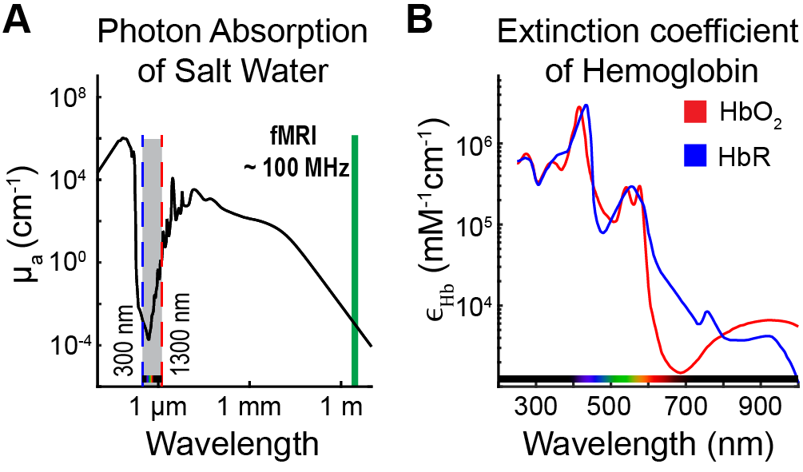
Reconstructed Data – Data Objects
The data outputs of NeuroDOT’s image reconstruction process are cortex_mu_a and cortex_Hb.
cortex_mu_a: muA image volume.
First dimension: number of voxels.
Second dimension: number of time points.
Third dimension: number of wavelengths used by imaging system.
cortex_Hb: image volume containing hemoglobin concentrations.
First dimension: number of voxels.
Second dimension: number of time points.
Third dimension: 2, corresponding to oxy and deoxy hemoglobin concentrations.
Cortex_Hb is then split into two additional variables for oxy and deoxy-hemoglobin: cortex_HbO and cortex_HbR.
muA @ 750nm is sensitive to HbR
muA @ 850nm is sensitive to HbO

Slide 36


Reconstructed Data – Metadata Objects
The metadata outputs of NeuroDOT’s image reconstruction process are two info structures, info for the A matrix, and info for the fNIRS data.
In NeuroDOT pipelines these variables are named as follows, and contain:
A matrix: A.info.
Optodes: Optode locations.
Pairs: Measurement list.
Tissue: Volumetric and anatomical information relative to A Matrix and its generation process.
fNIRS data: info.
IO: Data acquisition information.
Optodes: Optode locations.
Pairs: Measurement list.
Paradigm: Simulus encoding.
System: Framerate of imaging system.
Tissue: Information about the light model.
Units: Units corresponding to various fields in the metadata structure.
MEAS: Measurement level data quality assessments such as: standard deviation of measurements and good indices of measurements based on the std.

Slide 37


Reconstructed Data – Visualization
Reconstructed data
on top of
Volumetric Data.
Reconstructed data can be visualized on both volumetric or surface objects.
Volumetric: PlotSlice, PlotSlices, PlotSlicesTimeTrace.
Surface-based: PlotMeshSurface, PlotInterpSurfMesh.
For an in-depth look at NeuroDOT’s suite of visualization functions, see the visualization tutorial.
PPT: NeuroDOT_Tutorial_Visualization_Overview.
Script: NeuroDOT_Visualization_Script.m.
Reconstructed data
on top of
Surface Data.

Slide 38
That’s It (For Now)
Congratulations! You have finished the NeuroDOT Tutorial for Data Organization.
See other Sample Results Appendices for example visualizations of these same processing steps on the other Sample Data included in the toolbox.
Also, see the PreProcessing and Reconstruction tutorials to gain a deeper understanding of the effects of altering the processing parameters.
NeuroDOT Team:
Adam Eggebrecht (aeggebre@wustl.edu)
Emma Speh (espeh@wustl.edu)
Ari Segel (ari@wustl.edu)

